Slide 1
Deep Learning in Practice
Artificial Intelligence
December 2, 2019

Slide 2
Our Plan
M | 11/18/2019 | Deep Learning | Deep MLPs and Convolutional Neural Networks
W | 11/20/2019 | Deep Learning | Sequence Learning & LSTMs | Assignment 4 (Neural Networks) - due 11/22
M | 11/25/2019
W | 11/27/2019
M | 12/02/2019 | Deep Learning | Deep Learning in Practice
W | 12/04/2019 | AI Ethics & Society | TBD | Debate Prep
M | 12/09/2019 | Deep Learning | Quiz | Quiz 5
W | 12/11/2019 | AI Ethics & Society | TBD | Debate Prep + Assignment 5 (Deep Learning) - due 12/13

Slide 3

Deep Neural Learning
Intro to Deep Learning & Autoencoders
Convolutional Neural Networks
Deep Sequence Learning (LSTM)
Deep Learning in Practice

Slide 4
Agenda
Gradient descent and its variants
Normalization and Batch normalization
Regularization via Dropout
Hyperparameter tuning
Transfer learning

Slide 5
Useful Online Resources
https://towardsdatascience.com/batch-mini-batch-stochastic-gradient-descent-7a62ecba642a
https://medium.com/@ilango100/batch-normalization-speed-up-neural-network-training-245e39a62f85
https://machinelearningmastery.com/dropout-for-regularizing-deep-neural-networks/
http://cs231n.github.io/transfer-learning/

Slide 6
Gradient descent variants

Slide 7
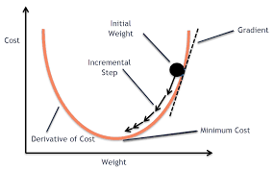
What is gradient descent?

Slide 8
Types of Gradient Descent
Stochastic Gradient Descent (SGD)
Update weights after each training example
Stochastic - bouncing from training example to example
Avoids local minima but slow and difficult to converge
Batch Gradient Descent
Run all the training examples (called a training epoch)
Compute average error and then update weights
Fast but can stuck in local minima
Mini-Batch Gradient Descent
Combine the two – process a batch of examples (usually 32) and then update weights

Slide 9
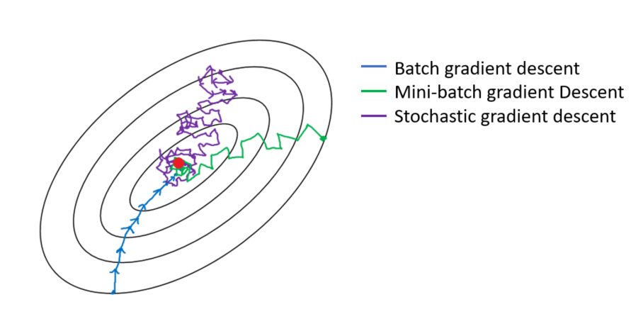
Comparison

Slide 10
normalization & batch normalization

Slide 11
Normalization
Normalize means (z-score standardize)
z = (x – mean)/stdev
Result is mean of 0 and standard deviation of 1
For a normal distribution, 68% of values lie within 1 SD (Z of 1 or -1); 96% between 2SDs, and 99% between 3 SDs
Effect is that variables on different scales (e.g., x1 from 0 to 1 and x2 from -300 to 300) are now on the same scale (typically from -3 to 3)

Slide 12
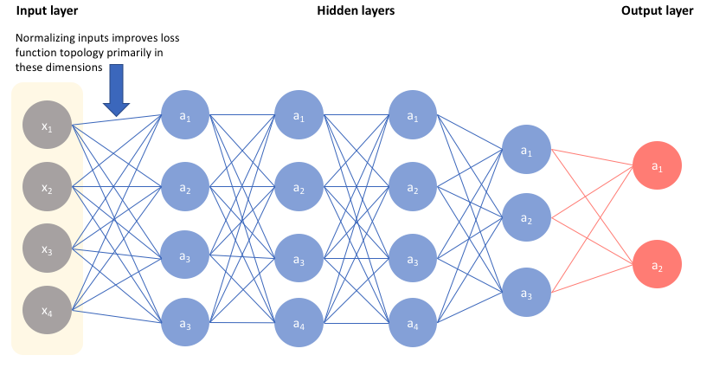
Input Normalization
It is standard to normalize inputs in neural networks

Slide 13
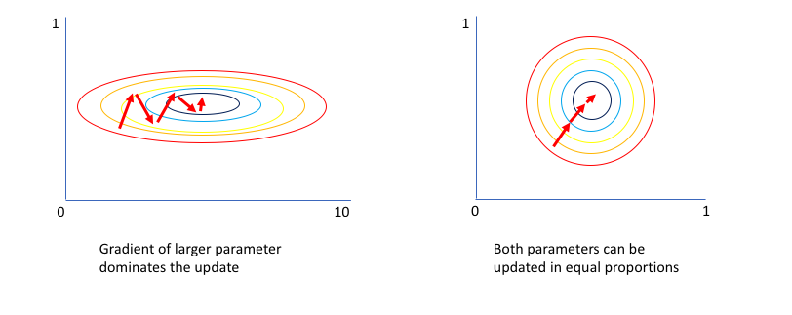
Input normalization improves the learning process

Slide 14
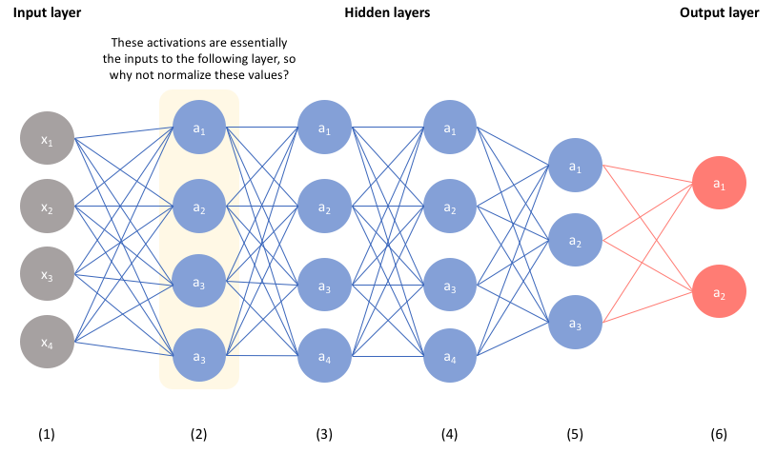
Why not extend this to hidden layers

Slide 15
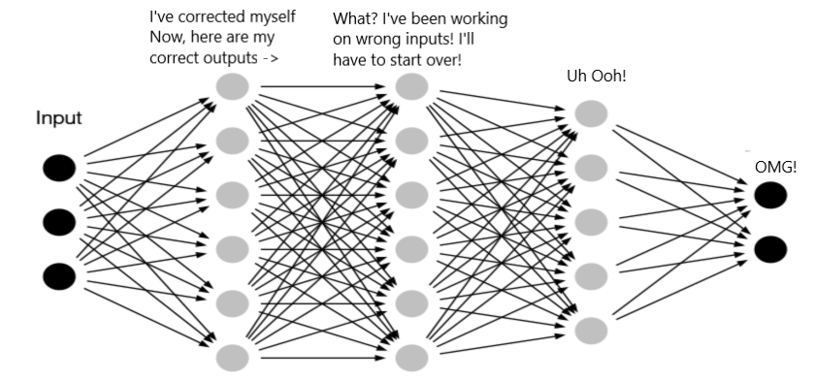
Addresses the Internal Covariance Shift Problem
Each layer adjust weights from forward propagation error
But now subsequent layers are working on different input
Slows down training

Slide 16
regularization via dropout

Slide 17
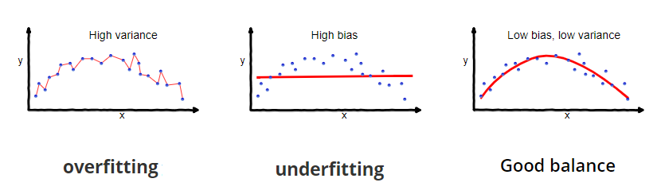
What is the bias-variance tradeoff?

Slide 18
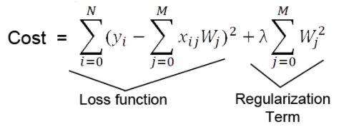
What is regularization?
A penalty term applied to prevent overfitting
In the example below, the cost increases for each added parameter (m)
Lambda is a regularization parameter

Slide 19
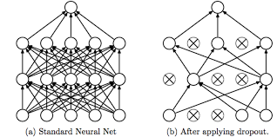
Dropout is an easy and effective way to achieve regularization
Basic idea is to randomly delete neurons at training

Slide 20
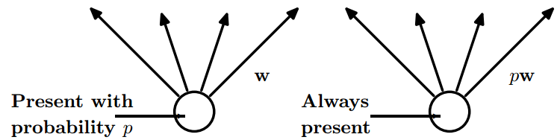
Dropout probability
At each training iteration, retain each neuron with a probability of p
At test, scale each weight by a factor of p

Slide 21
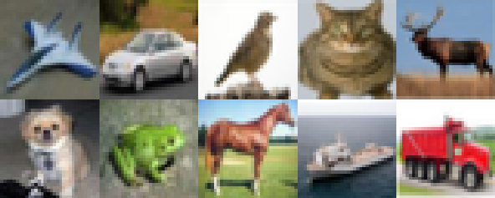
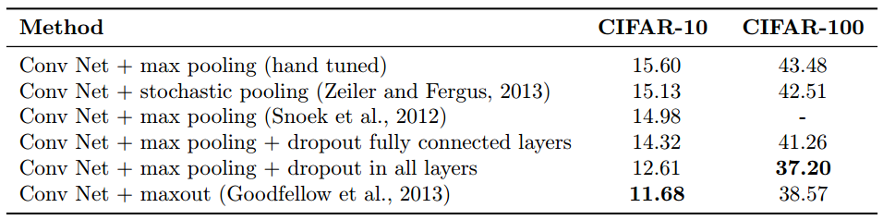
Dropout is surprisingly effective
The CIFAR challenge pertains to the task of classifying objects in images. CIFAR-10 indicates 10 class labels (unique objects) whereas CIFAR-100 indicates 100 labels.

Slide 22
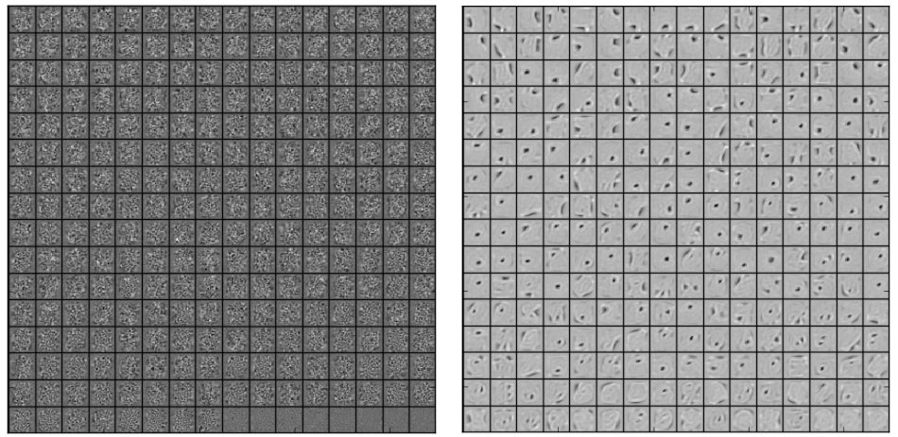
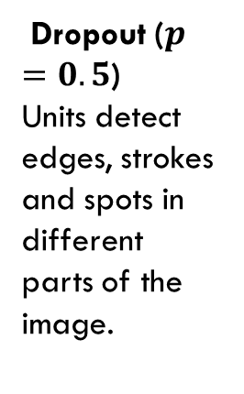
Why is dropout effective?
Without dropout, hidden units compensate for other units since they are interconnected
This leads to overfitting, since co-adaptations do not generalize
Dropout prevents co-adaptations by making the presence of other hidden units unreliable
MNIST, one hidden layer, 256 ReLUs
No dropout
Units have co-adapted. Each unit does not detect a meaningful feature.
Dropout ($p=0.5$)
Units detect edges, strokes and spots in different parts of the image.

Slide 23
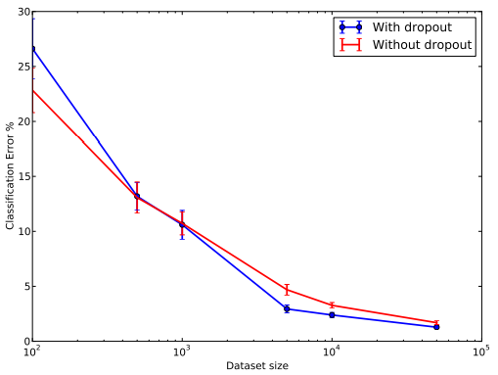
Effectiveness varies by dataset size
Extremely small data set
Dropout does not improve error rate, and even makes it worse.
Huge data set
Dropout barely improves the error rate. The data set is big enough, so that overfitting is not an issue.
Average to large data set
Dropout improves error rate

Slide 24
hyperparameter tuning

Slide 25
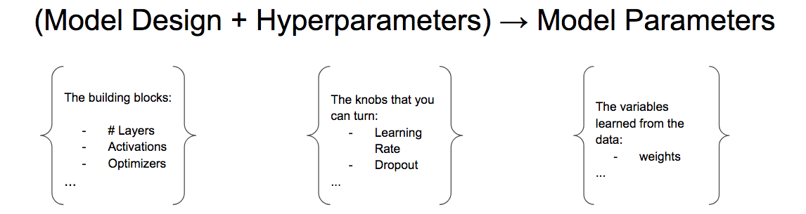
What is a parameter and hyperparameter?
Parameters pertain to model coefficients (weights)
Hyperparameters (knobs) that affect the learning process
Fixed via nested cross-validation

Slide 26
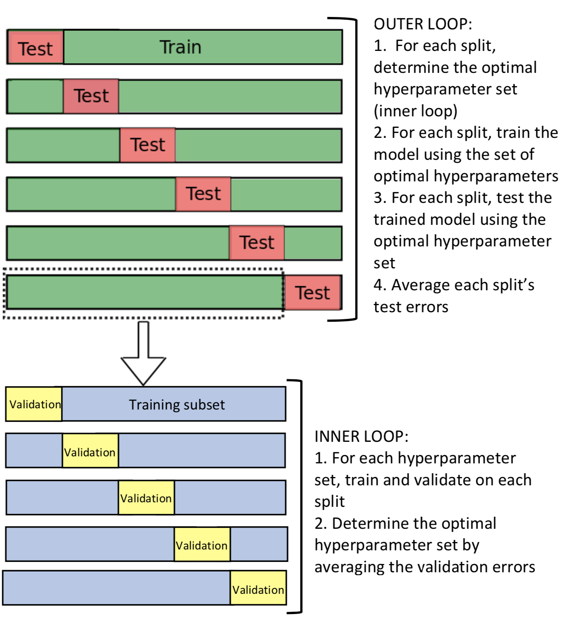
What is cross validation?

Slide 27
Nested Cross-Validation

Slide 28
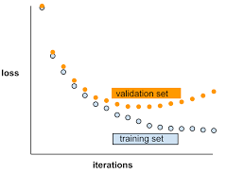
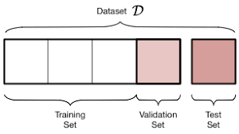
Validation Loss
We now have training (to learn weights), validation (to set hyperparameters), and test (to evaluate performance) sets
Validation loss is error on validation set
Used to assess underfitting and overfitting

Slide 29
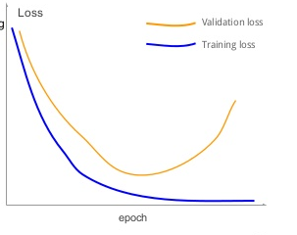
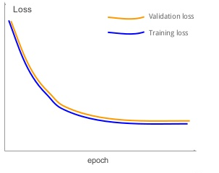
Underfitting or Overfitting?
Left curve overfits – training loss decreases but validation loss increases
Right curve underfits – training/validation loss stop decreasing

Slide 30
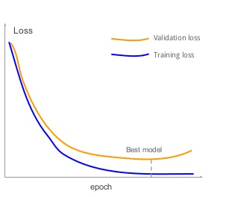
About right
Training loss decreases over time (epochs)
As does validation loss – it saturates but does not increase

Slide 31
transfer learning

Slide 32
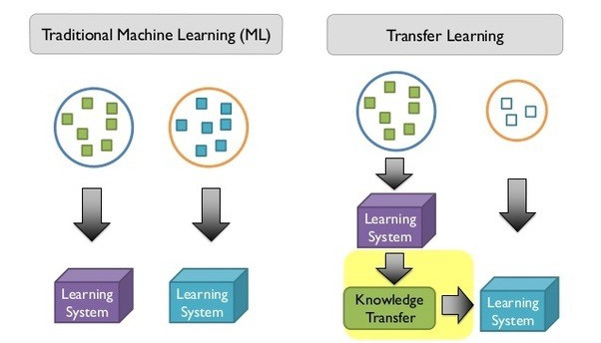
What is transfer learning?
A model for one task (source domain or task) is reused as the starting point for a second task (target domain or task)

Slide 33
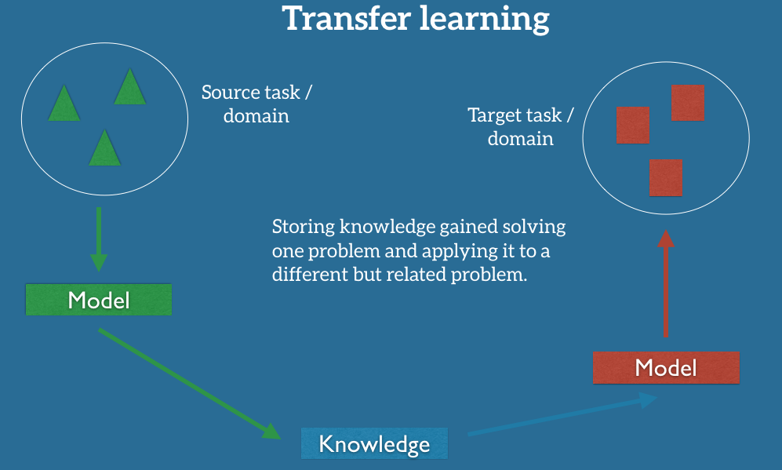

Slide 34
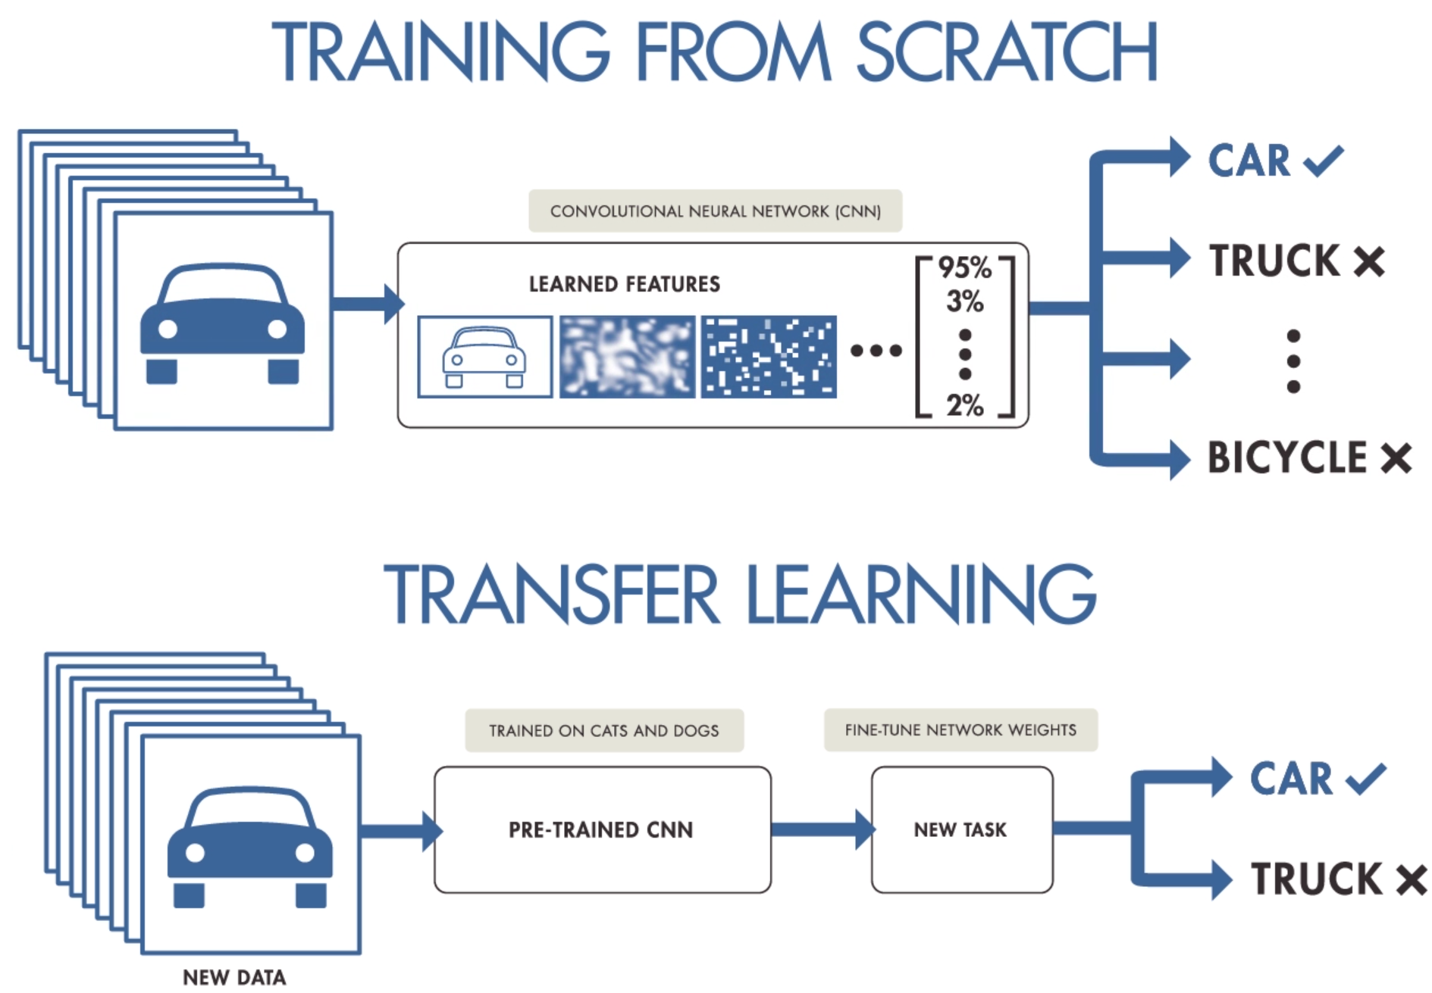
Transfer Learning with CNNS

Slide 35
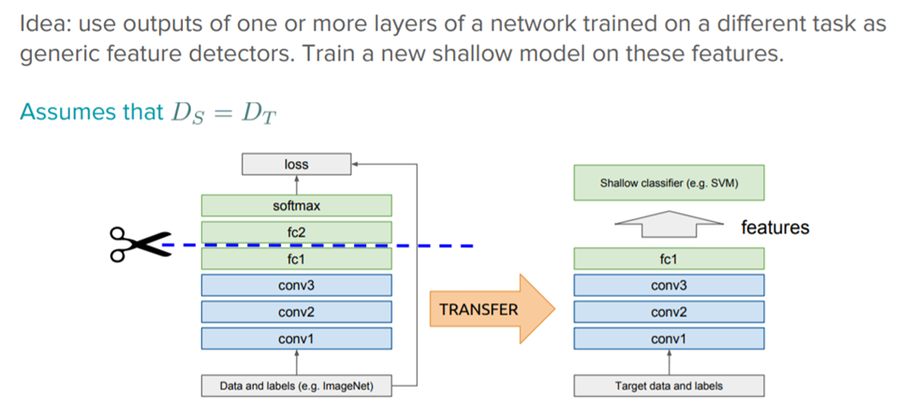
Use features from flattened layers as inputs for new task

Slide 36
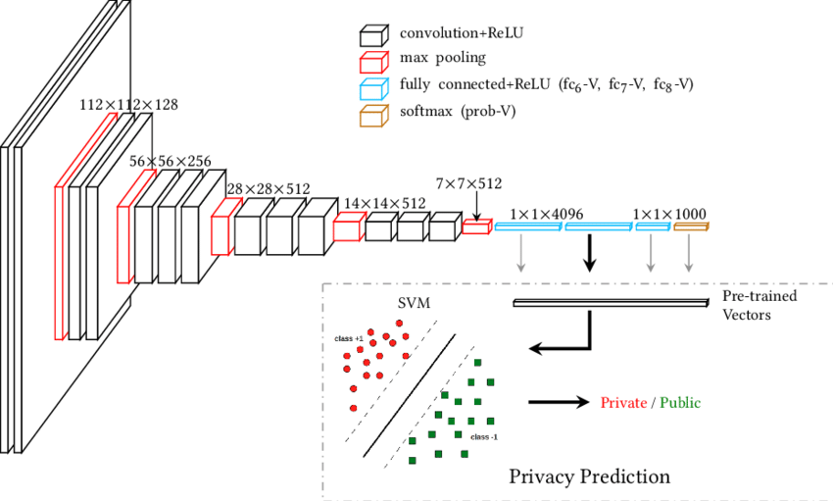
Example “Image encoding using pre-trained CNN: (1) We employ a CNN (e.g. VGG-16) pre-trained on the ImageNet object dataset. (2) We derive high-level features from the image's visual content using fully connected layers (fc 6-V, fc 7-V, and fc 8-V) and probability layer (softmax) of the pre-trained network.”

Slide 37
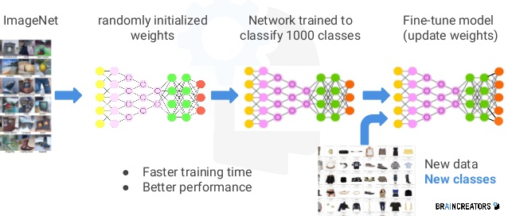
Can also fine tune source model based on target data

Slide 38
review

Slide 39
Review
What are the three types of gradient descent?
What is input normalization & batch normalization
What is regularization?
What is dropout?
When is dropout effective?
What is a parameter and a hyperparameter?
What is nested-cross validation?
What is validation loss?
How is validation loss used?
What is transfer learning?
How are CNNs used for transfer learning?

